Slide 1
Communication, Effective Communication
Dr. Syed A Aziz, Ph.D.
Research Scientist, Regulatory Toxicology Research Division, Health Canada,
Adjunct Professor, Faculty of Medicine, Department of Pathology and Laboratory Medicine, University of Ottawa, Canada.
saziz@uottawa.ca

Slide 2
Why this topic

Slide 3
Social Media

Slide 4
Think once before you act,
Think twice before you speak,
Think thrice before you post on Facebook.

Slide 5
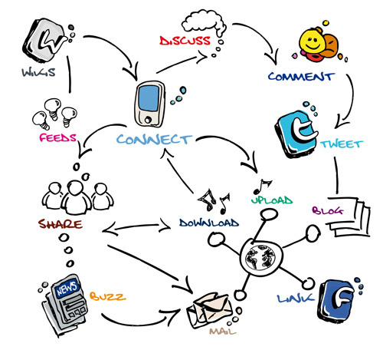
Communication

Slide 6
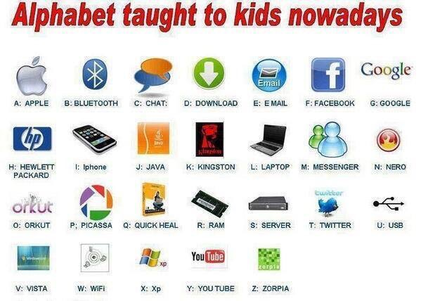
Communication Alphabets

Slide 7
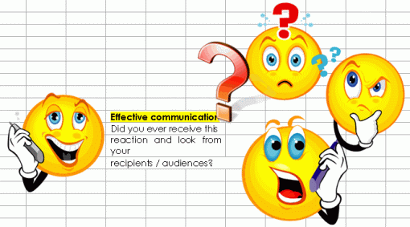
Effective Communication

Slide 8
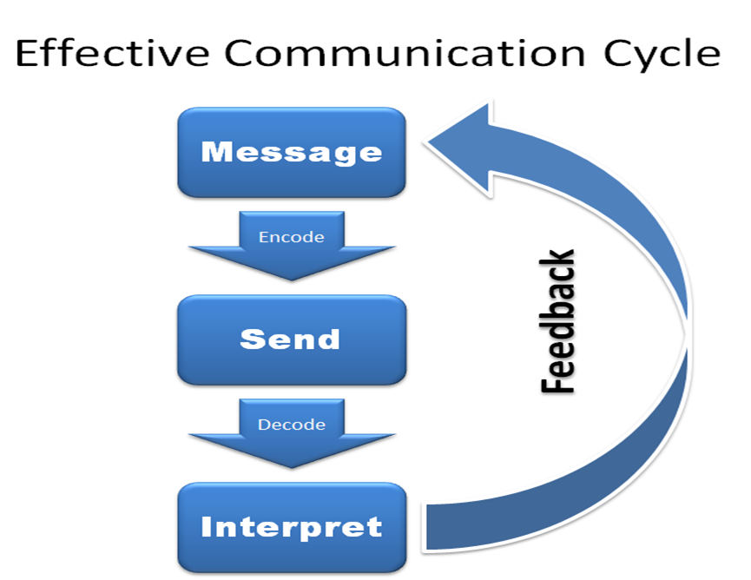
The Communication Process
The effective communication process is a six step cycle, and unfortunately the communication can break down or become confused at any step.
Sometimes the symbolic message isn't even clear in our own brain, and yet we still expect others to know what we mean!
Then the encoding, sending, and decoding phases all provide opportunities for errors and misunderstandings to crop into the process.
In the fifth step, the receiver has to filter the message and decide what it means based on their own values, beliefs, filters, and memories.
If any of these steps fails, the result is confusion, conflict, and frustration.

Slide 9
There are 7 C’s of effective communication which are applicable to both written as well as oral communication.
1- Completeness.
The communication must be complete. It should convey all facts required by the audience.
The sender of the message must take into consideration the receiver’s mind set and convey the message accordingly.
2- Conciseness.
Conciseness means wordiness, i.e, communicating what you want to convey in least possible words without forgoing the other C’s of communication.
Conciseness is a necessity for effective communication.

Slide 10
There are 7 C’s (Cont.)
3- Consideration
Consideration implies “stepping into the shoes of others”.
Effective communication must take the audience into consideration, i.e, the audience’s view points, background, mind-set, education level, etc.
Make an attempt to envisage your audience, their requirements, emotions as well as problems.
4- Clarity
Clarity implies emphasizing on a specific message or goal at a time, rather than trying to achieve too much at once.

Slide 11
There are 7 C’s (Cont.)
5- Concreteness
Concrete communication implies being particular and clear rather than fuzzy and general.
Concreteness strengthens the confidence.
6- Courtesy
Courtesy in message implies the message should show the sender’s expression as well as should respect the receiver.
The sender of the message should be sincerely polite, judicious, reflective and enthusiastic.

Slide 12
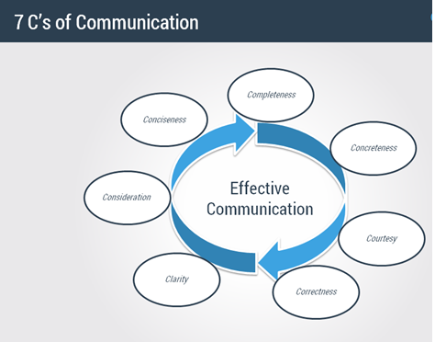
7- Correctness
Correctness in communication implies that there are no grammatical or spell errors in communication.

Slide 13
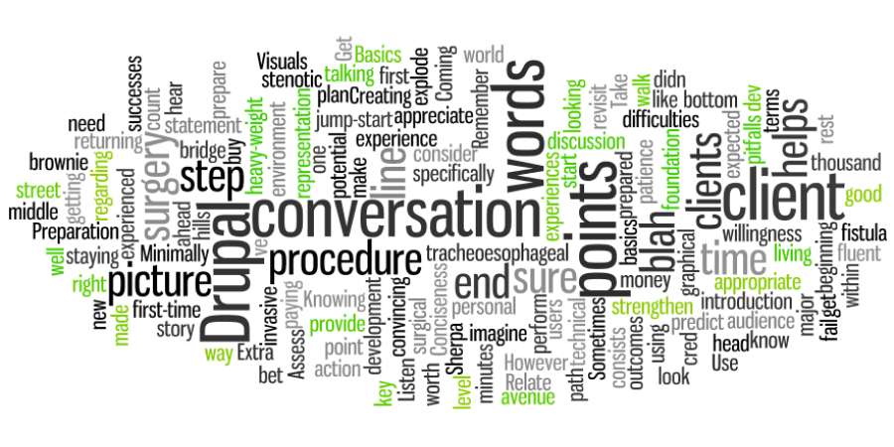
Six Basic Principles of Effective Communication

Slide 14
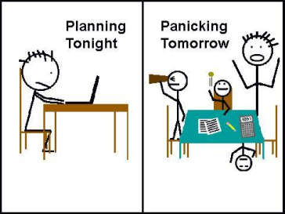
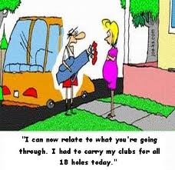
Effective communication.
It's easy to talk about,
key to a smooth operation,
but difficult to master.
Listen.
Basics.
Preparation.
Visuals.
Conciseness.
Relate.

Slide 15
Professional touch

Slide 16
E-mail Account
Free Email accounts (Amateur)
Hotmail
Yahoo
Gmail
Zoho Mail
Yandex.Mail
AIM Mail
iCloud Mail
Outlook.com
Mail.com
Shortmail
Inbox.com
Facebook Messages
My Way Mail
Professional
cmail.carleton.ca
uottawa.ca
edu.
org.
gc.ca

Slide 17
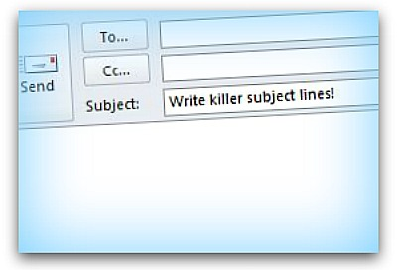
Subject
The most opened emails have subject lines of two words or less.
On average, these types of emails had an open rate of 80%.
The second most opened emails had no subject line at all and were simply Re: or Fwd:
Subject lines with 5 or more words were the least opened with an opening success rate of under 15%.
Using simple, direct words like ‘Update’ or ‘Intro’ in an email had a nearly 90% chance of being opened.

Slide 18
Last but not least
?
Questions

